Slide 1
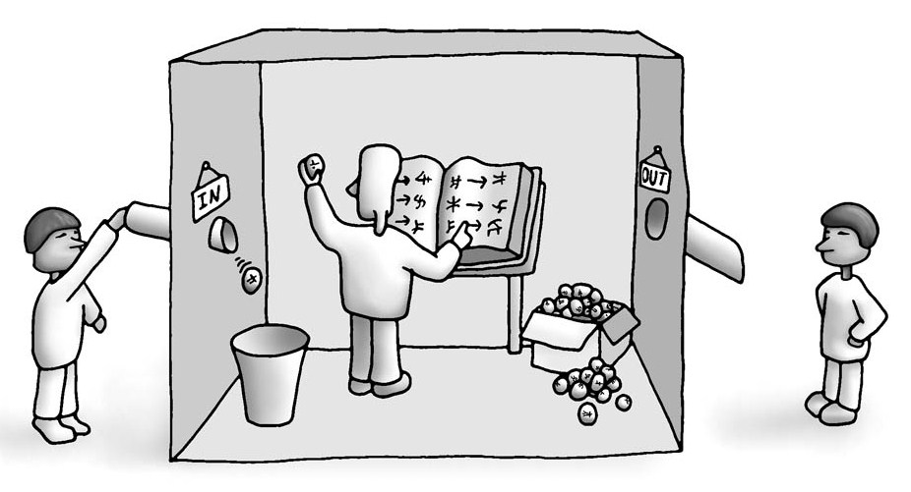
The Chinese Room
COMP 4230
David J Stucki
Fall 2021
https://commons.wikimedia.org/wiki/File:2-chinese-room.jpg

Slide 2
Alerts
Read Chapter 2 of Larson
Read both articles by Douglas Hofstadter on self-reference
Read John Searle's 1980 paper

Slide 4
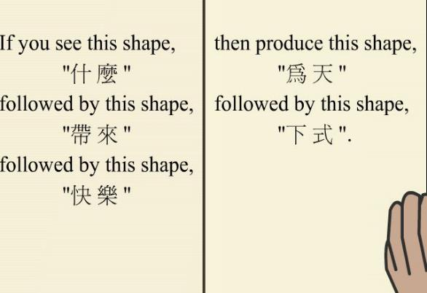
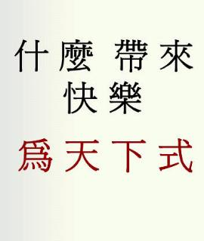
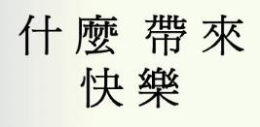
How The Chinese Room Operates https://mind.ilstu.edu/curriculum/searle_chinese_room/searle_chinese_room.html
What brings happiness?
Be the stream of the universe.
(Lao-Tzu's Tao Te Ching)

Slide 5
Meanwhile, Outside The Room
This guy is so smart!

Slide 6
Chinese Room Reflections
1980 John Searle: Brain and Behavioral Sciences (BBS)
What was Searle's point?
Even if a computer passes the Turing Test, it won't be intelligent because it still won't understand anything it says.
Turing himself had suggested some possible objections to machine intelligence. He gave them the following titles:
Theological, “Heads in the Sand”, Mathematical, Consciousness, Various Disabilities, ESP, Lady Lovelace’s Objection (originality), Continuity in the Nervous System, and Informality of Behaviour.
Searle’s argument appeared to be new, and was a death knell for interest in the Turing Test, at least for a decade.
No longer was the question "Can we pass the Turing Test?" but rather "What is required for understanding?"

Slide 7
Next Time…
GOFAI: Good Old Fashioned Artificial Intelligence

